Slide 1
The risks and benefits of social media
An interactive learning session for healthcare professionals
Notes:
Hi, welcome to the first of 4 mini presentations in which we aim to teach you about the risks and benefits of using social media as healthcare professionals. I will be discussing with you what social media is and the benefits associated with it.

Slide 2
Learning objectives
To understand how social media can be used by healthcare professionals
To understand the benefits and risks of healthcare professionals using social media
Familiarise yourself with the updated HCPC standards
Develop an action plan for how you might use social media in your healthcare profession
Notes:
WEBSITE

Slide 3
What is social media?
Social media is one of the best ways to reach a wide audience
56.2 million active social media users in the UK
Penetration rate of 78%
Average person spends 151 minutes per day on social media
"Websites and applications that allow you to create and share content and interact with other users"
Notes:
So, what is social media? Social media can be defined as any website or application that allows you to create and share content and interact with other users. It includes the obvious ones such as Facebook, X, Instagram, and TikTok but also includes some you may not consider as a typical social media such as Whatsapp, online forums, YouTube and LinkedIn.
Social media is one of the best ways to reach a large and diverse audience with recent statista surveys finding that there are over 56.2 million active social media users in the UK alone, making the penetration rate of social media within the UK approximately 78%, 16% higher than the global average of 62.3%. What’s more is the average daily use of social media is 151 minutes, over 2 hours.
Social media has lots of benefits in everyday use, such as keeping people connected allowing for easy communication across long distances. It also has lots of uses for healthcare professionals.

Slide 4
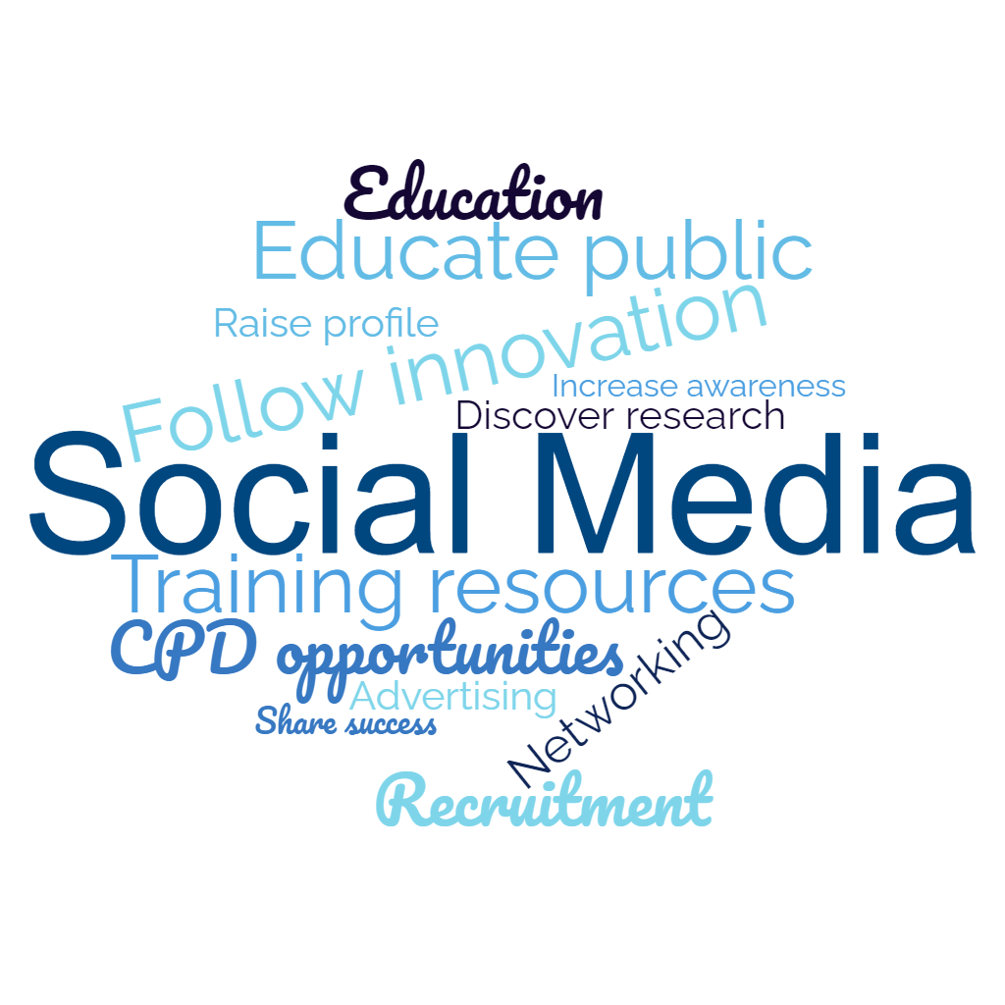
Notes:
Here is a word cloud representing some of the uses of social media for healthcare professionals. The one that probably springs to mind for a lot of people is networking and how social media can be used to make connections with other people working in your field. In addition to making these connections by following people within your field of healthcare science on social media you will be able to keep up with innovations and discover new research. You will also be able to promote any research you yourself carry out.
Further, social media is an excellent way to support training and continued professional development opportunities; by following people in the field, you may learn of webinars or workshops you can undertake to better your knowledge of your field or a field that links closely with yours. You may also need to be able to find educational videos on sites such as YouTube that would be able to teach you about different laboratory techniques etc.
The presence of healthcare professionals on social media can also be useful for patients and service users educating them on how the service is there to help them. It can also be used to promote individual services or trusts building confidence in a department. This departmental presence of social media can also be useful for recruitment, encouraging people to join a particular team.

